Slide 1

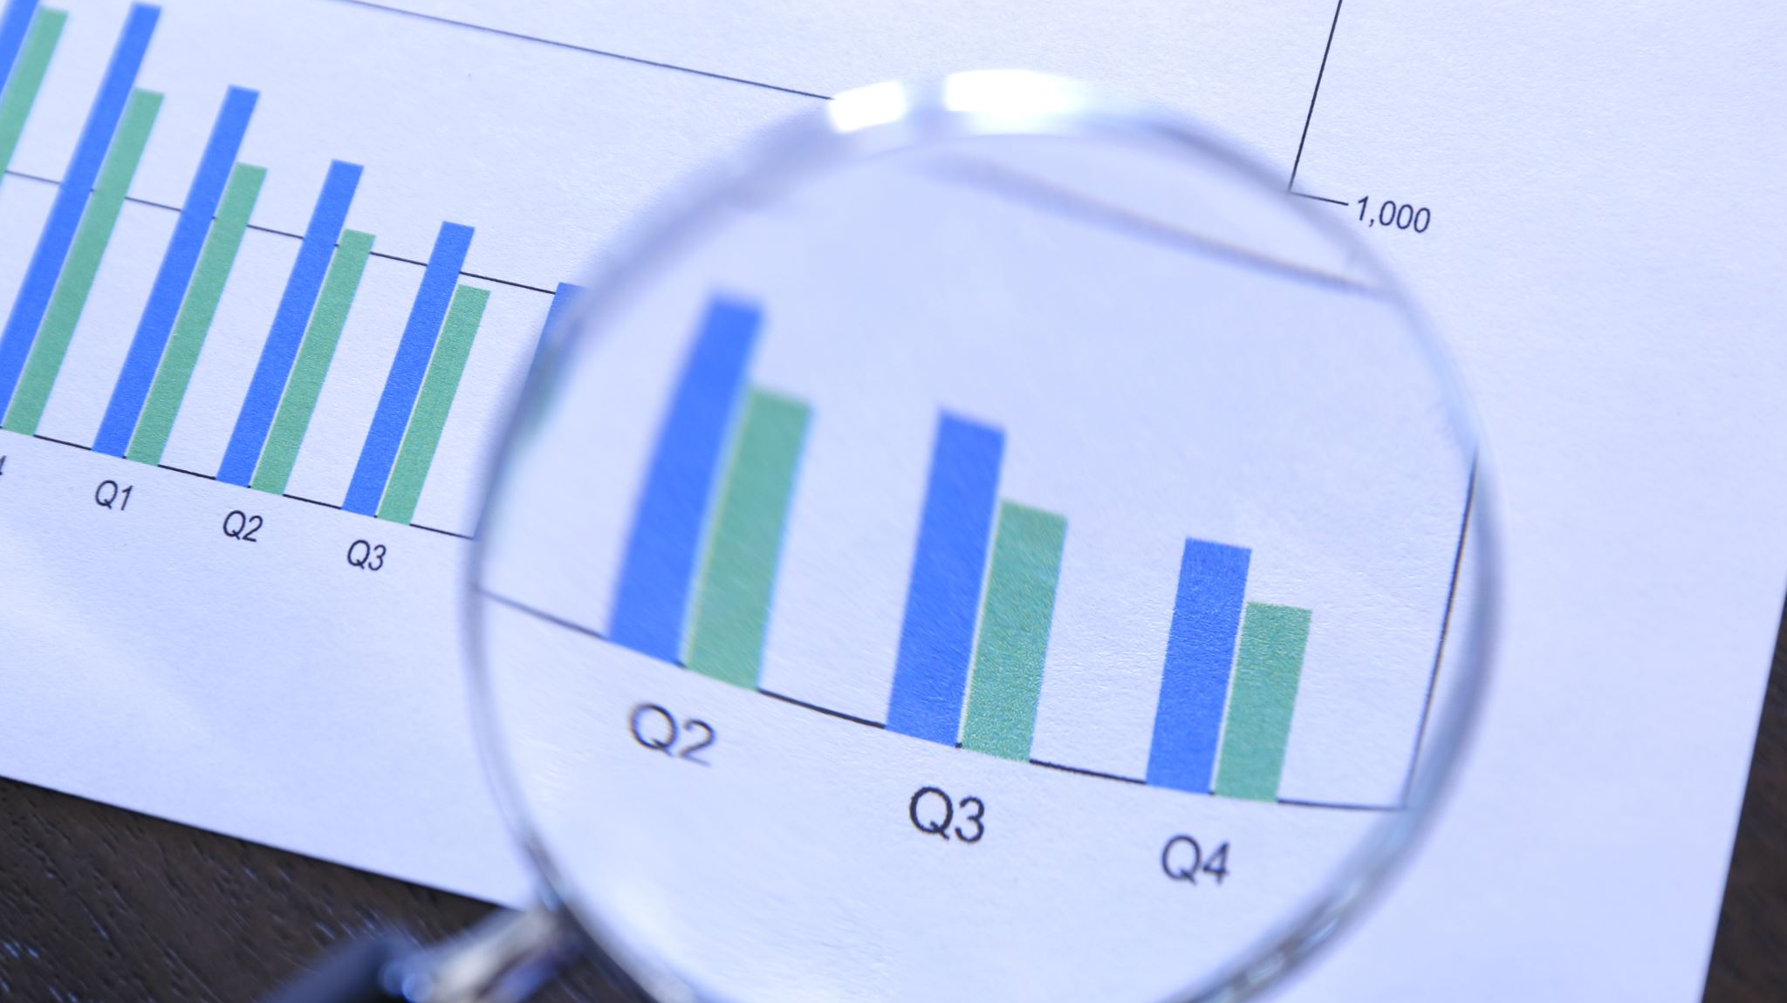
BlackRock Investment Analysis
Weekly status report 1

Slide 2
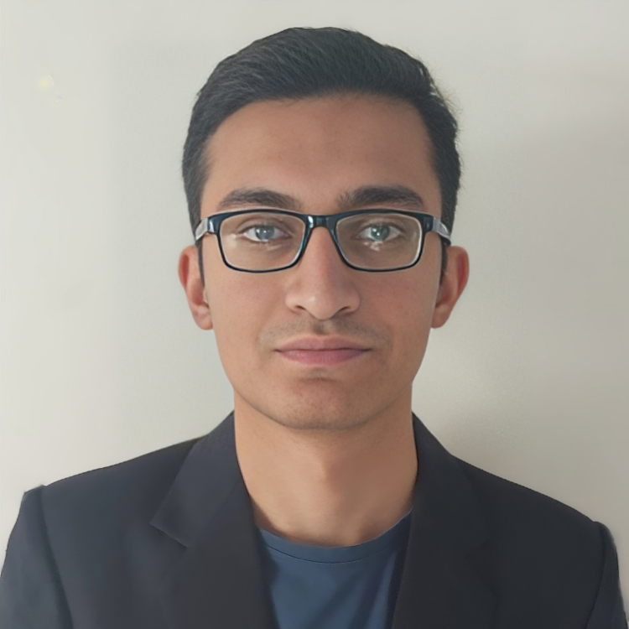
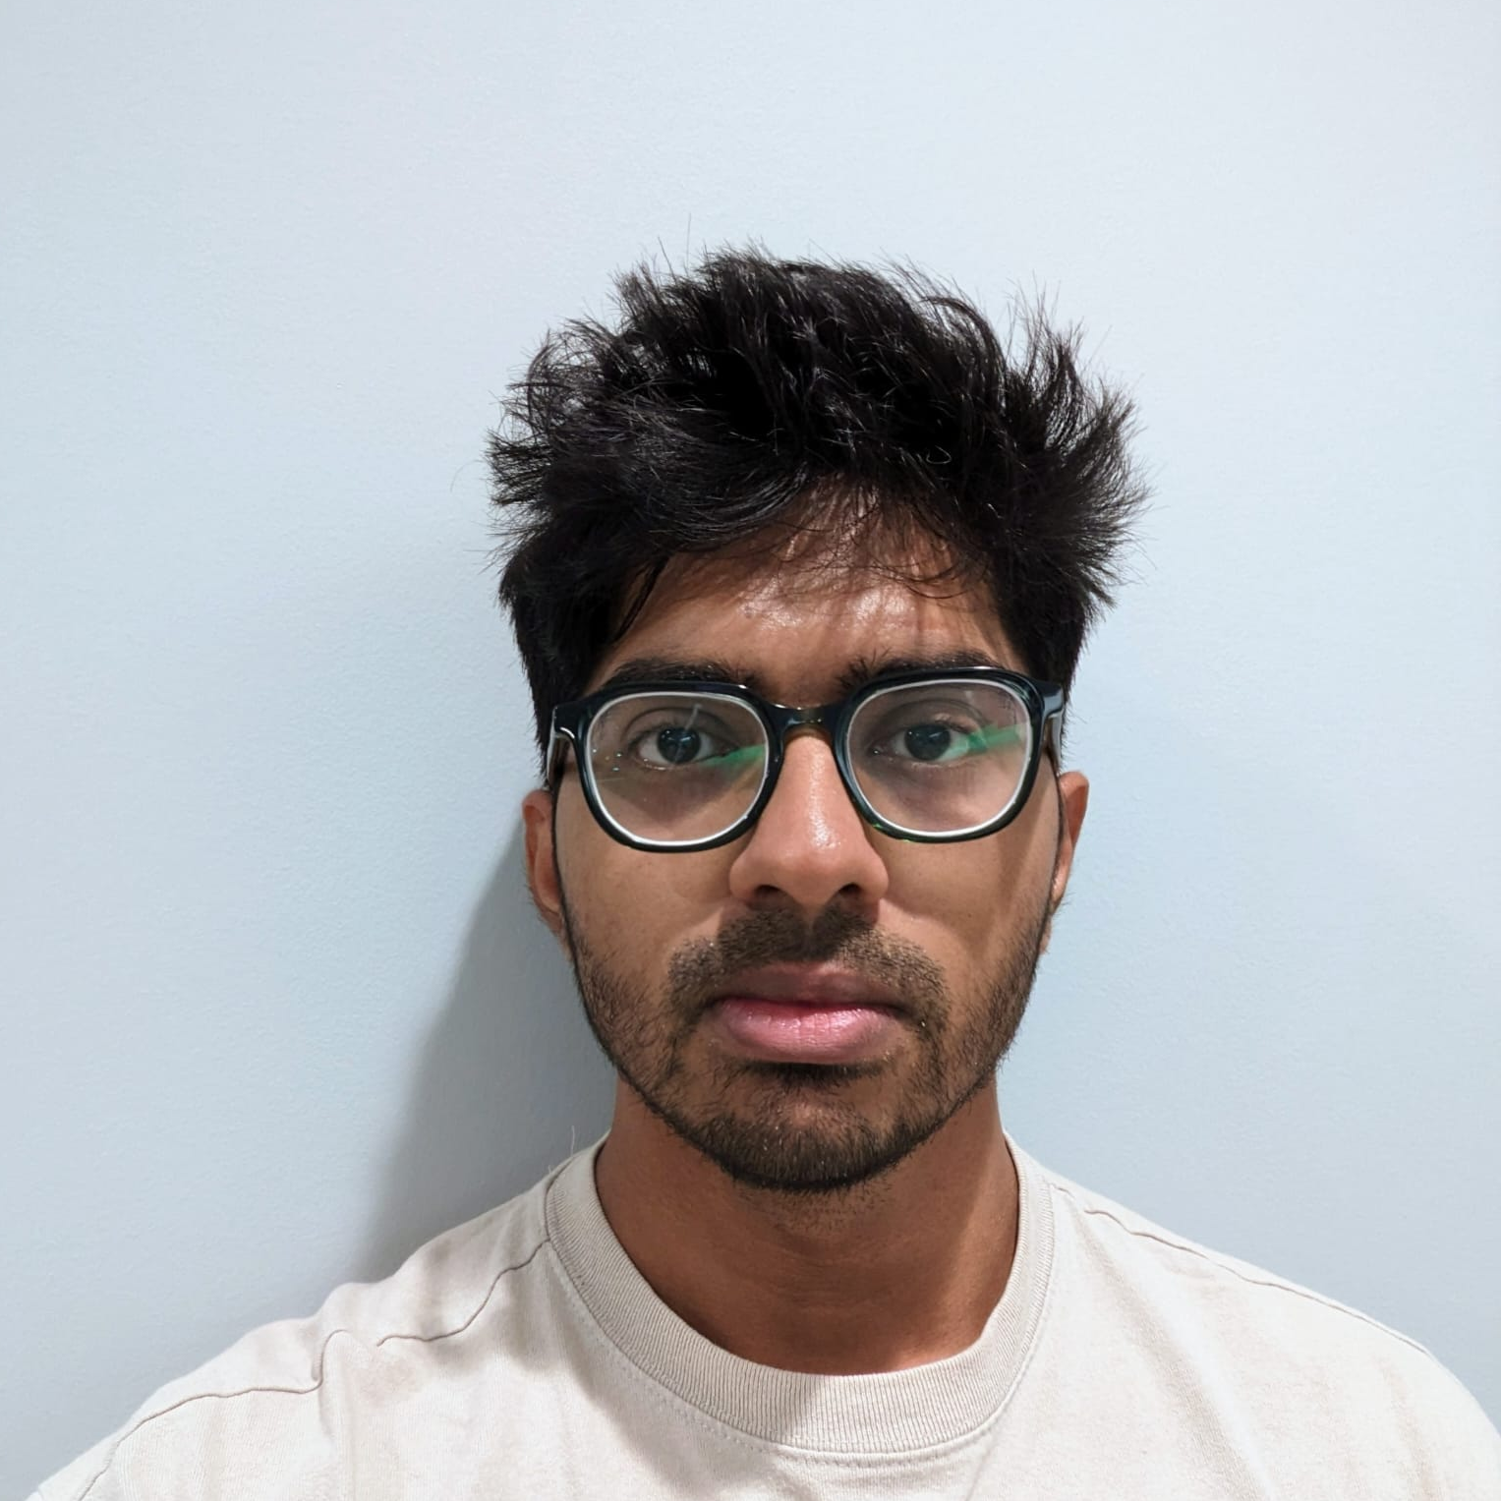

Team Members
Aryan Radadiya
Developer
Joyson Gonsalves
Team Lead
Sumit Kumar Pandey
Data Analyst

Slide 3
Date of Report: 16th January 2024
Date of Last Report: N/A
Prepared By: Group 7
Project Status: On Track

Slide 4

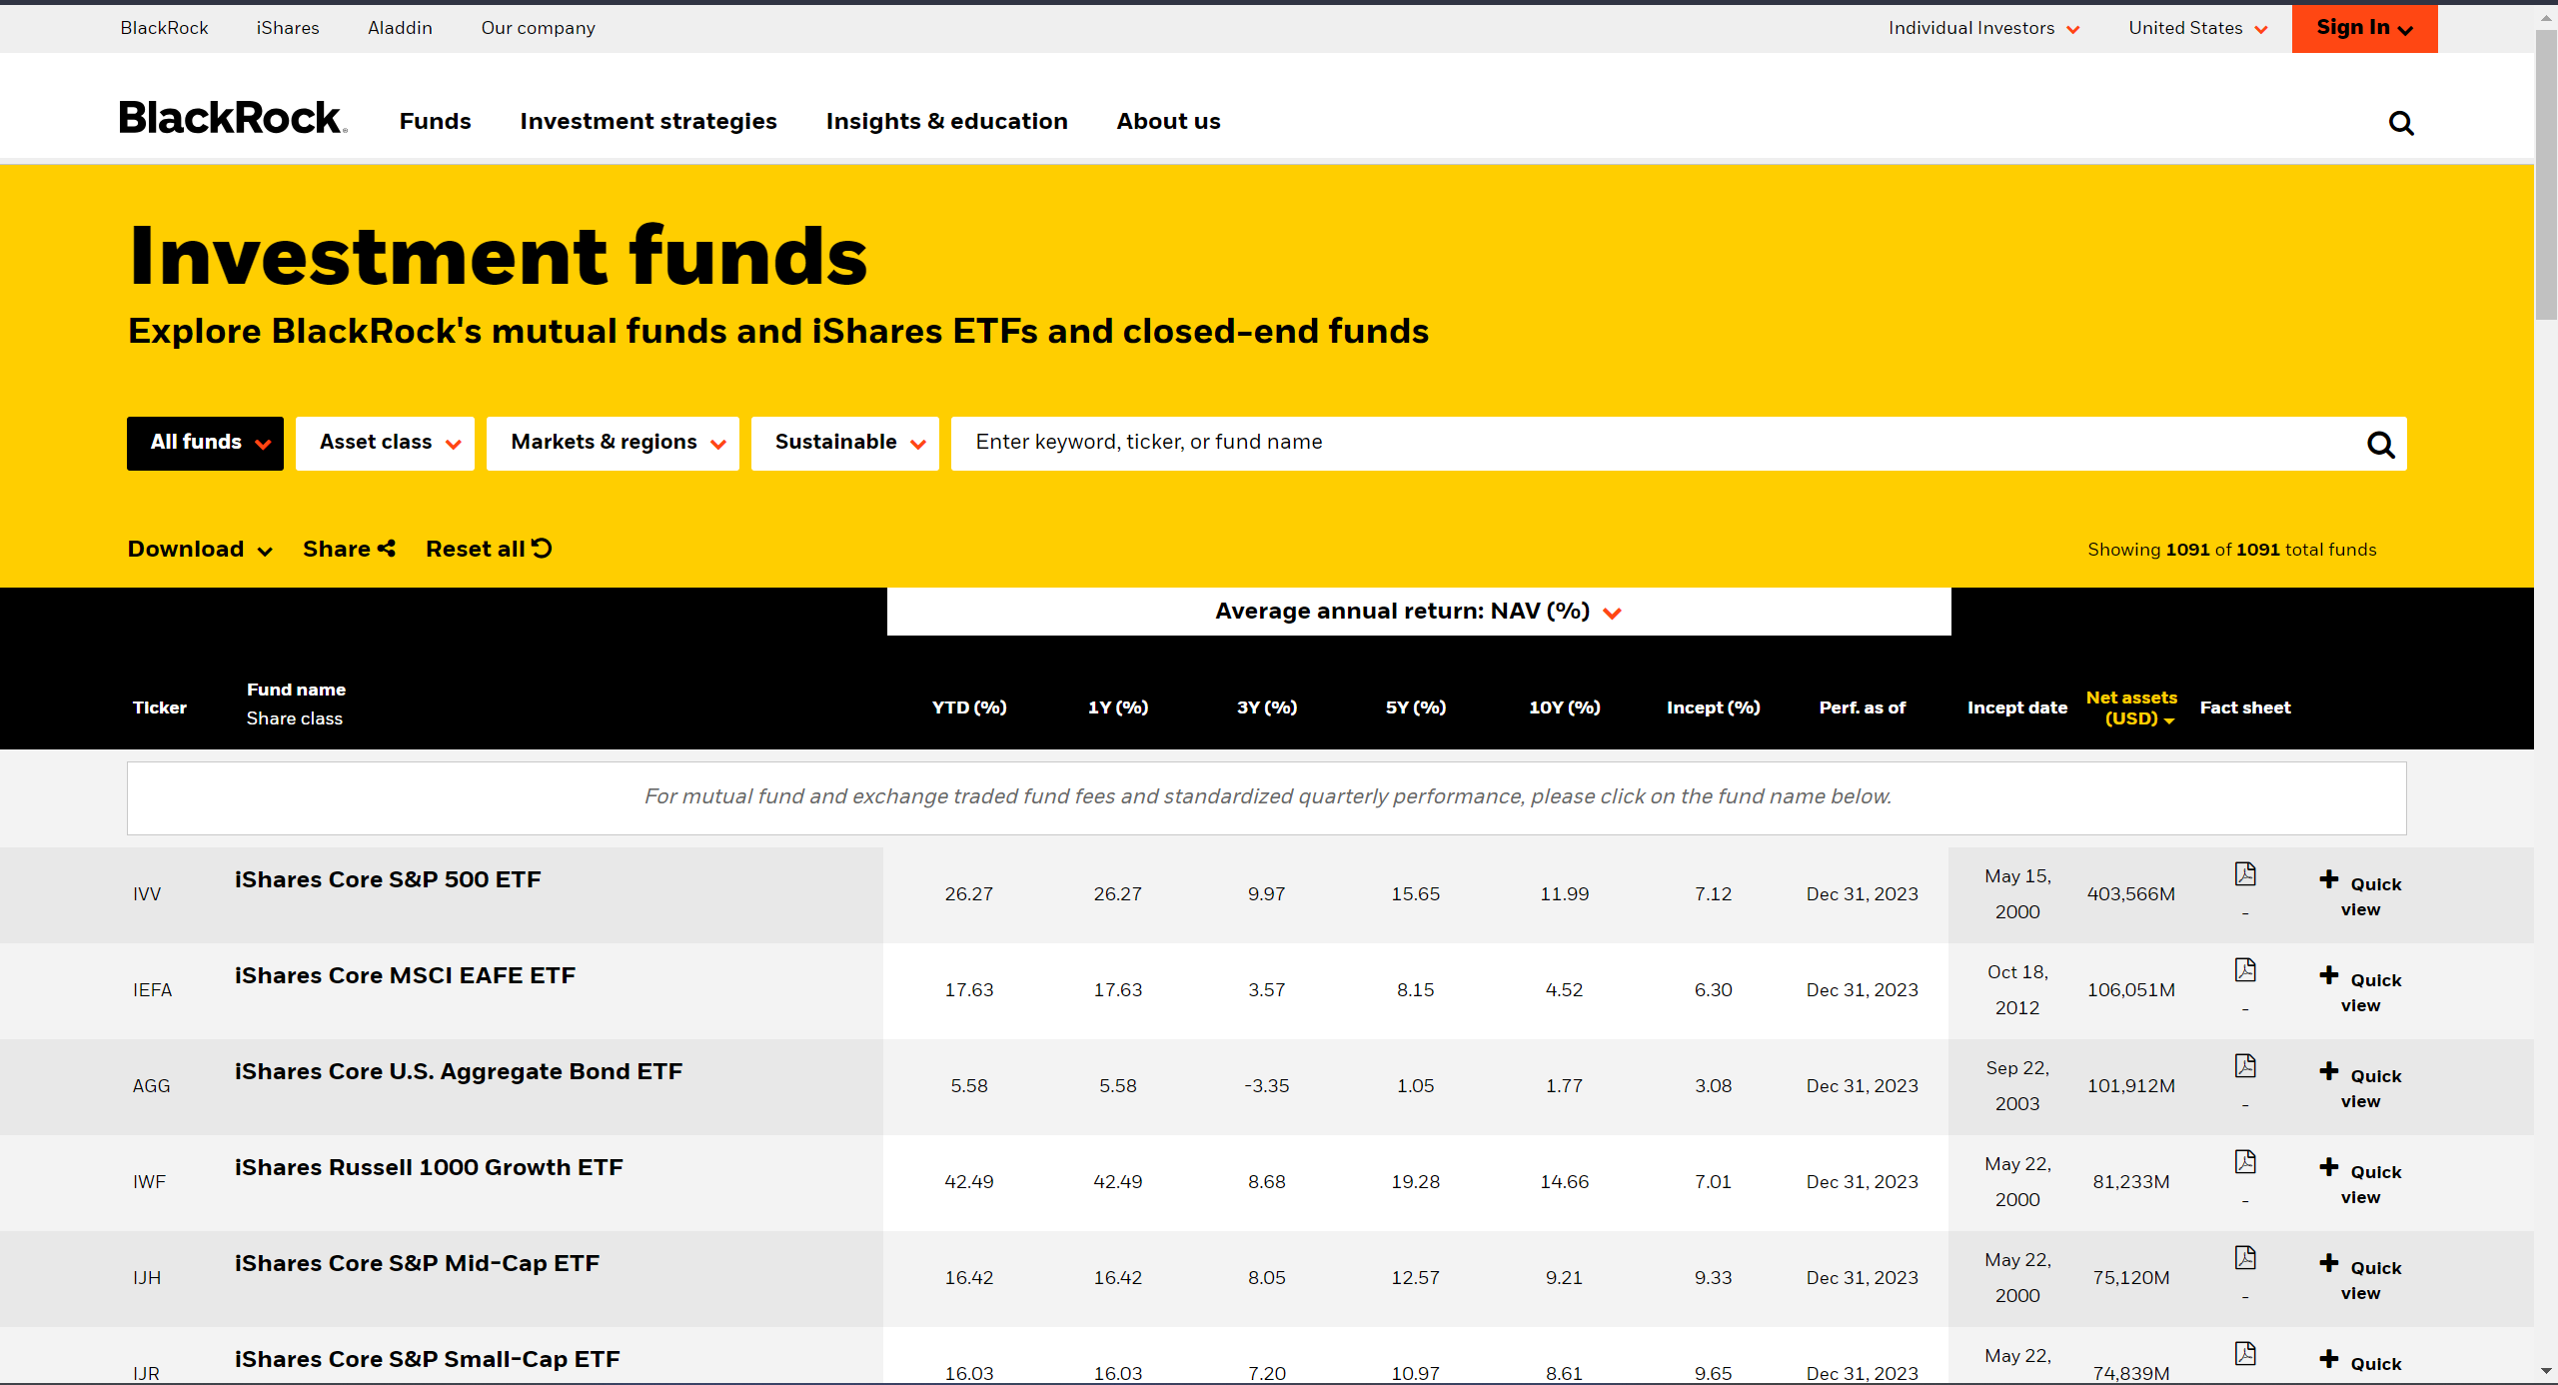
Activities Since Last Report
Collected data from the data source
Data Source: BlackRock Investment Funds

Slide 5
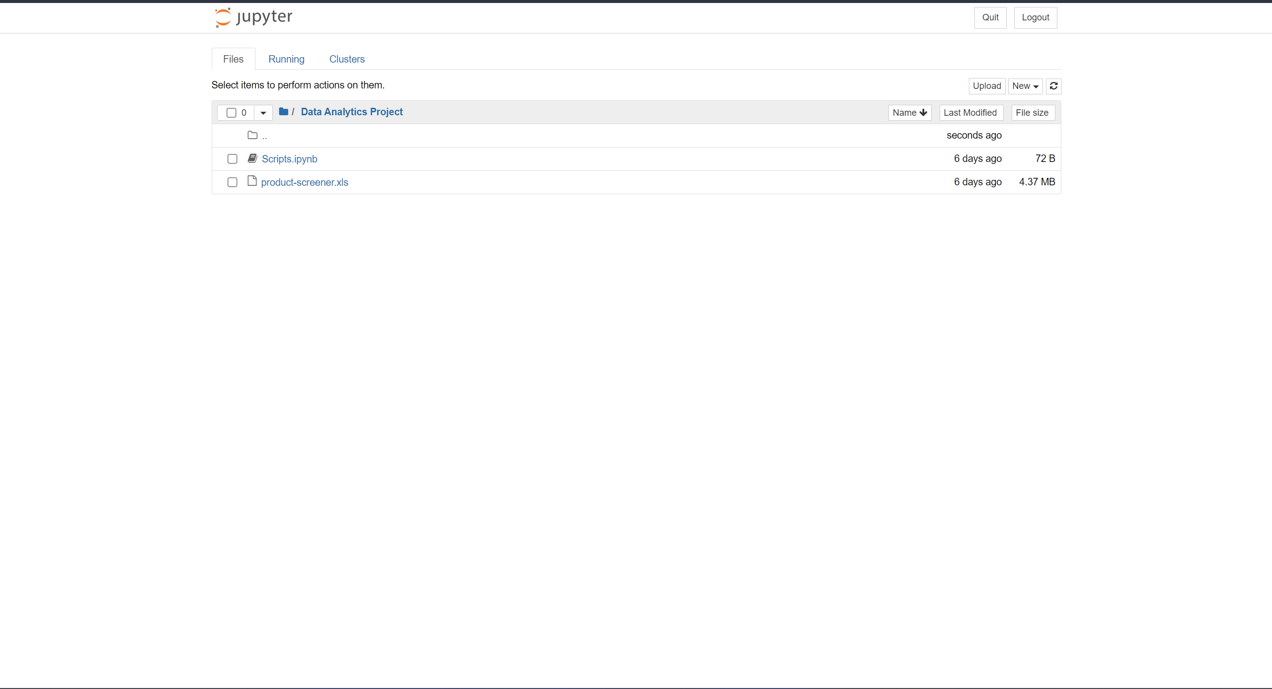
Importing data into python notebook

Slide 6



Communication
We had a phone conversation regarding the project progress and how we are going to proceed

Slide 7

Activities to be completed before next week
Completing the share point high level task list.
Start data cleaning and removing unwanted data.

Slide 8


Thank You Any Questions?

